Slide 1
NBA
Analysis
電機三 陳緯哲 陳品融 蔡秉璇

Slide 2
Topics
Big Three (but failed)
Age vs. Experience
Who is the "MONEY STEALER"?!
Which team makes the greatest deal?
W%/Pace vs. Attendance
Is Western Conference better than Eastern Conference?
Change of Styles

Slide 3
Introduction
Analysis & Visualization
Age vs. Experience
Who is the MONEY STEALER?!
Which team makes the greatest deal?
W%/Pace vs. Attendance
Is Western Conference better than Eastern Conference?
Change of Styles

Slide 4
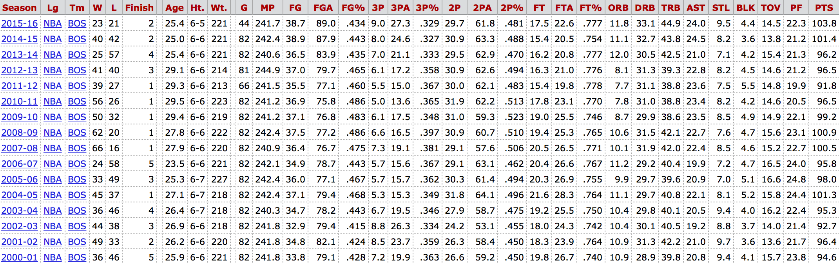
Age vs. Experience
Data Source
The whole league stats since 2000 (year by year)
How to calculate?
Using the data of assists per game and turnovers per game (AST/TOV)

Slide 5
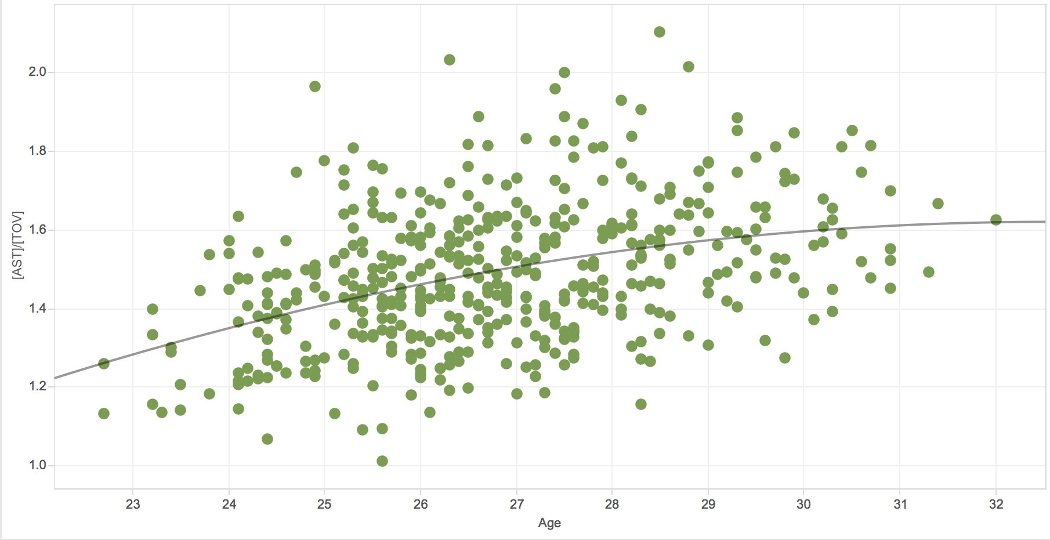
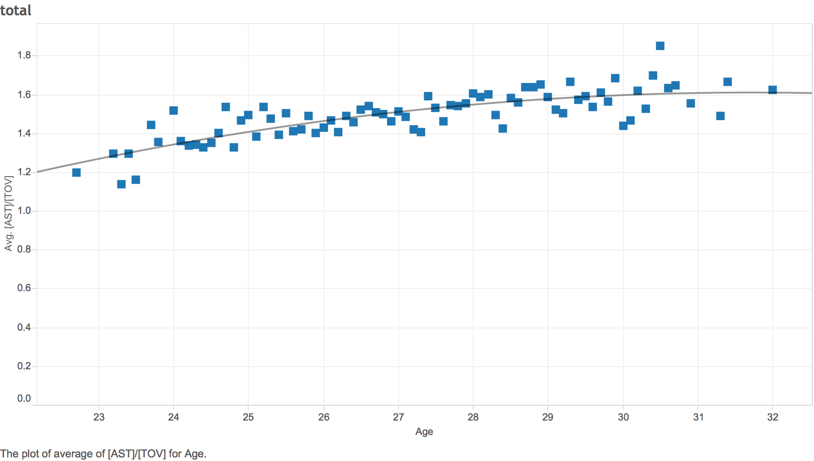
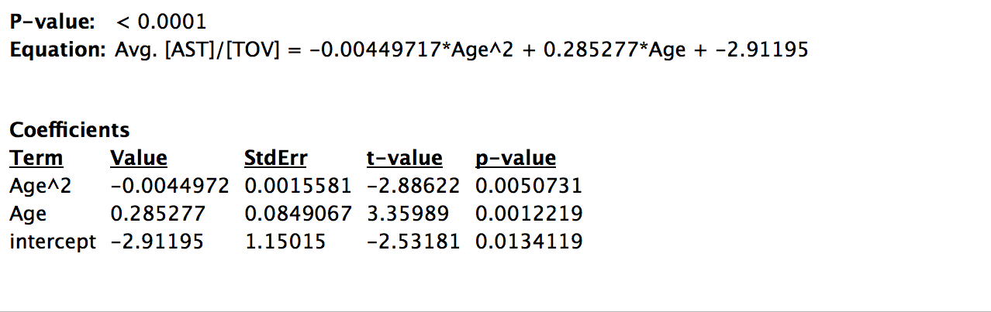
Visualization

Slide 6
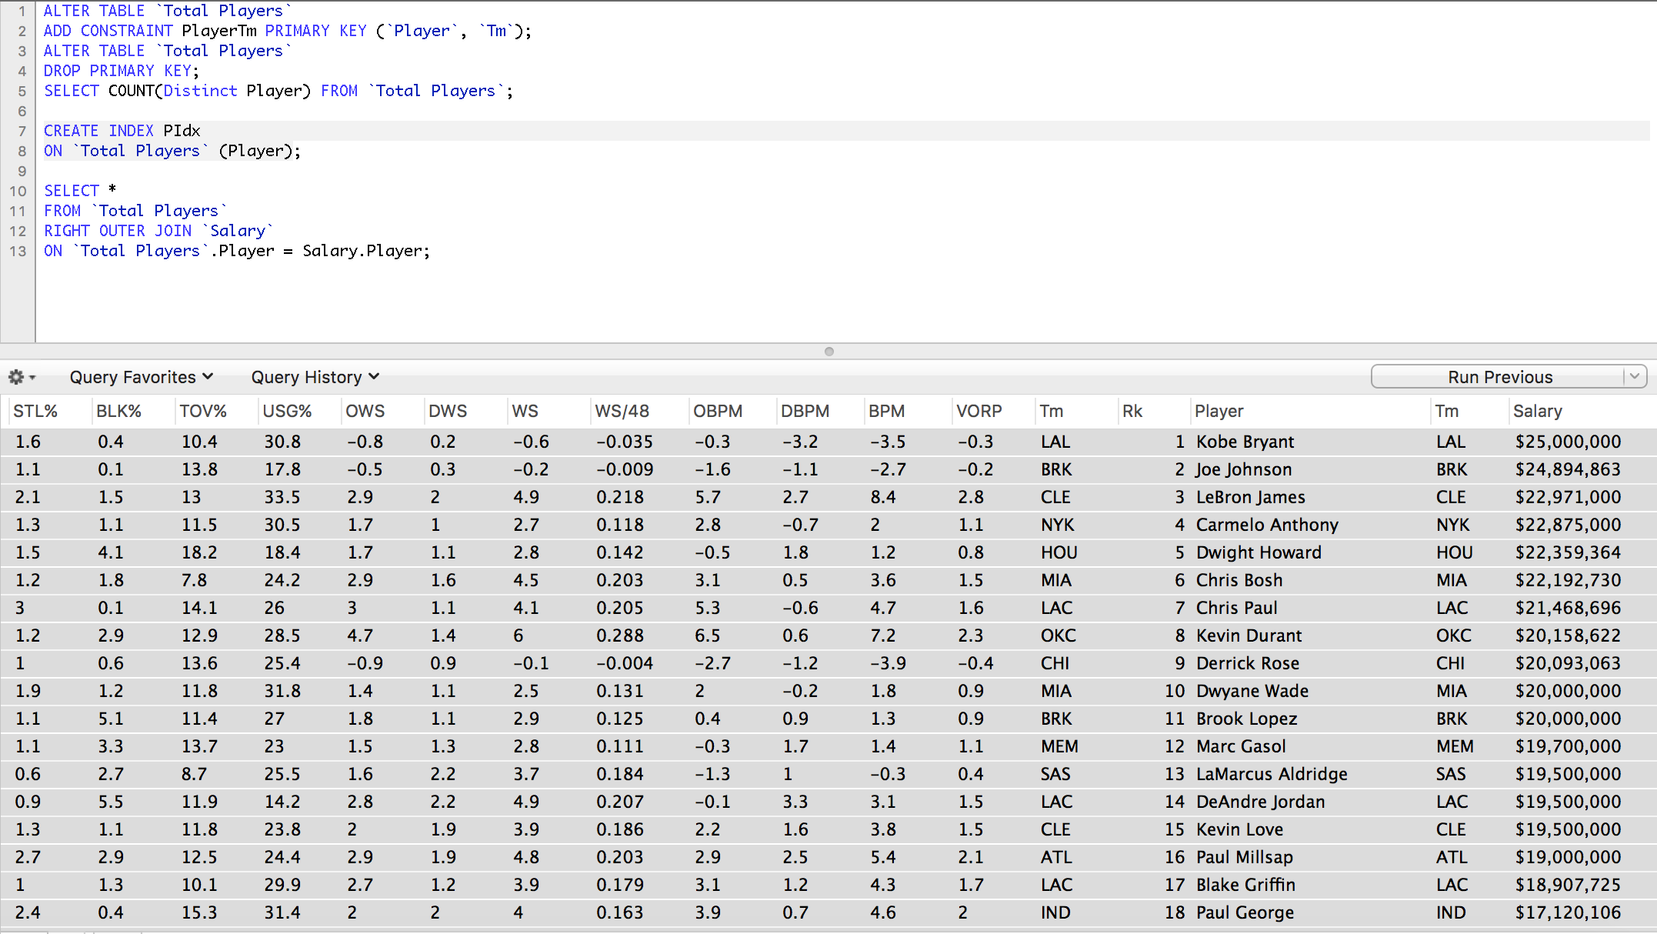
Who is the MONEY STEALER ?!
Data Source
Contracts of Players (2015-16), Players Advanced Stats

Slide 7
Visualization

Slide 8
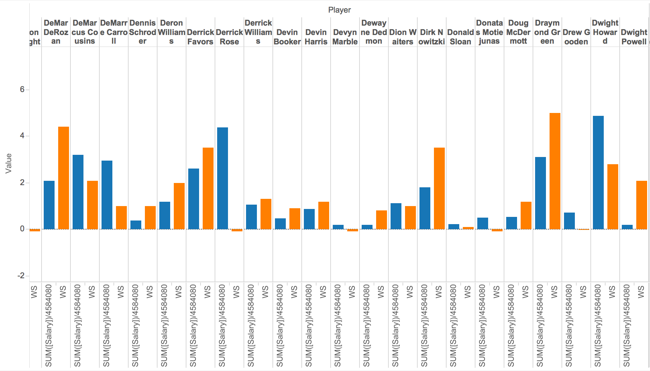
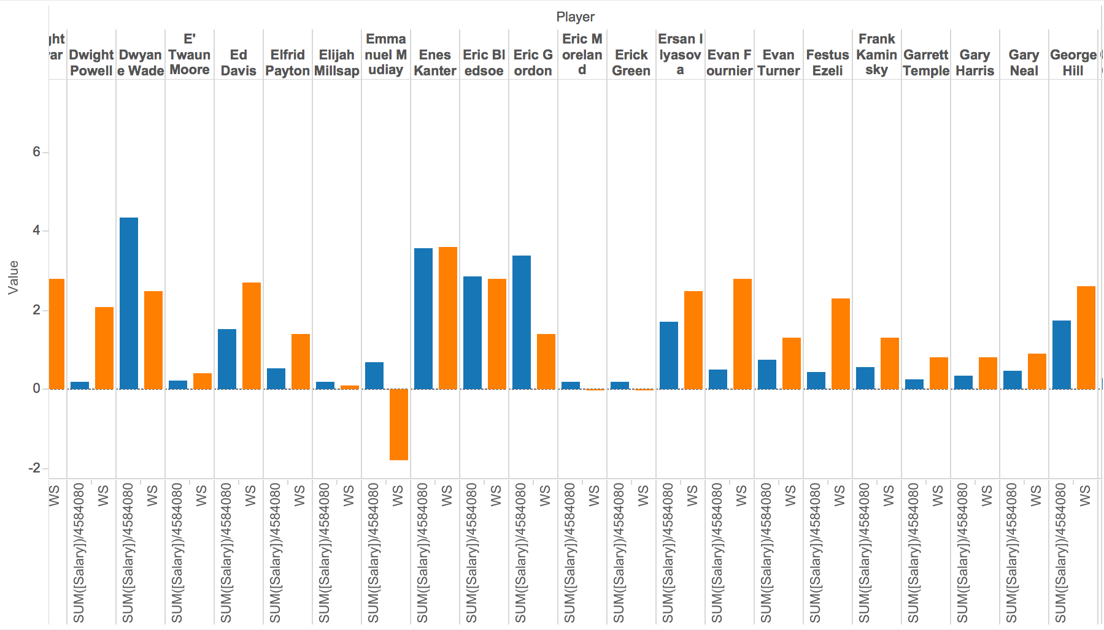
Visualization

Slide 9
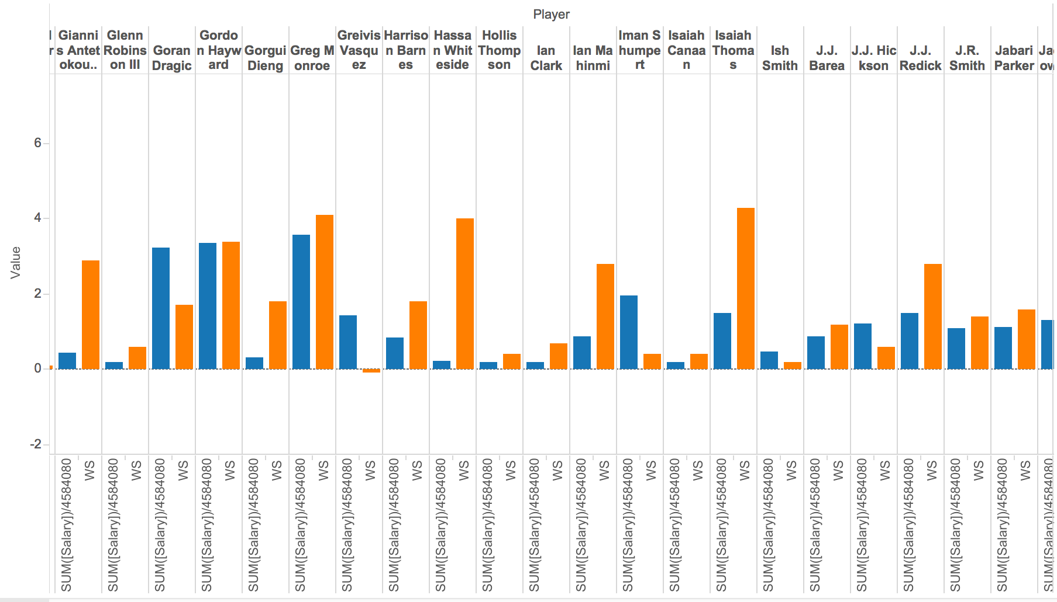
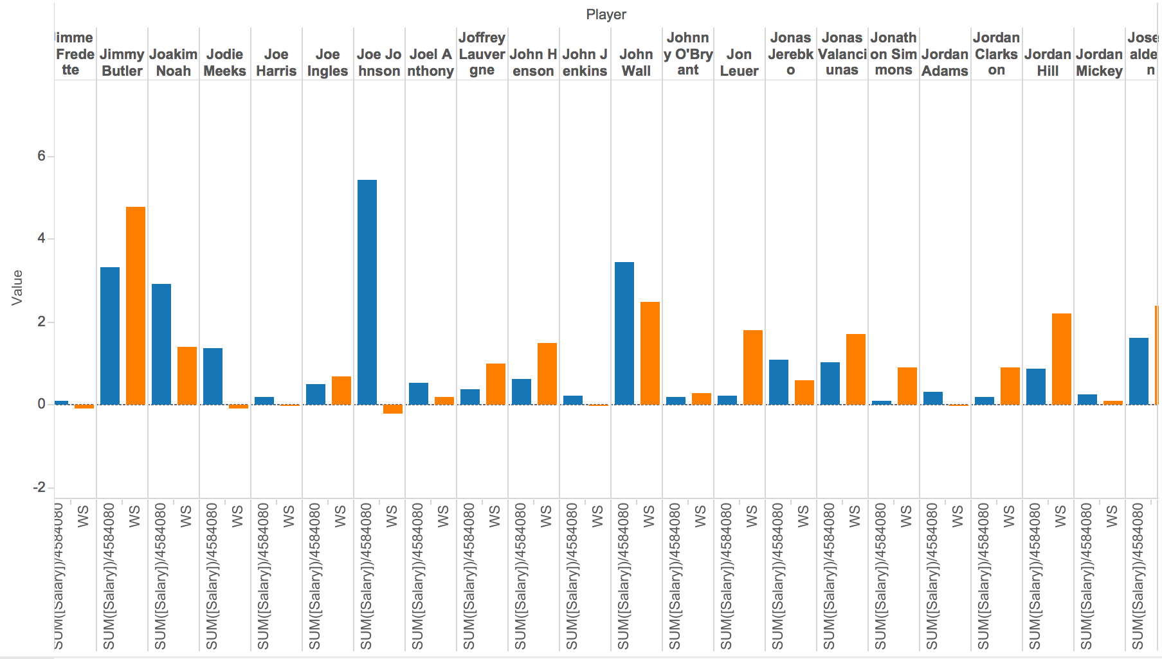
VISUALization

Slide 10
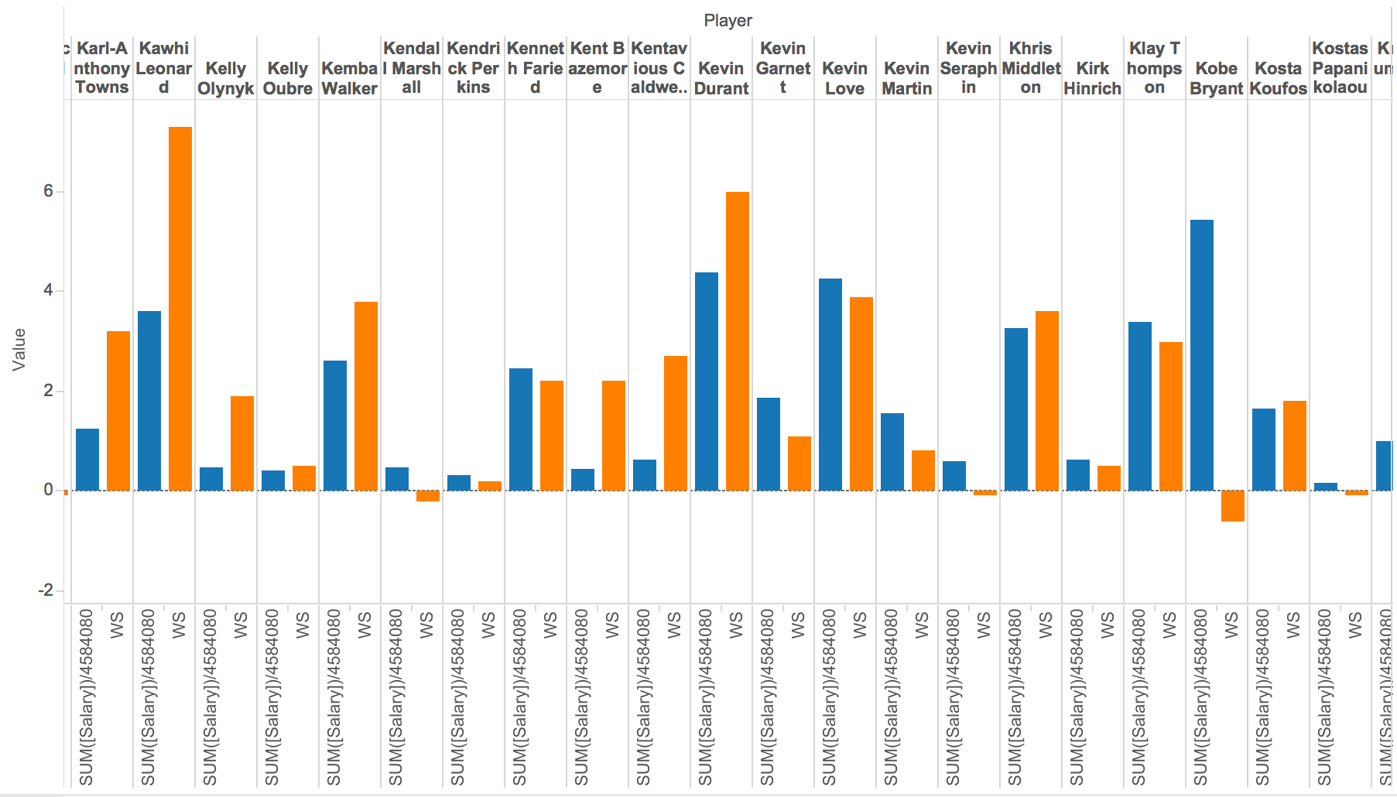
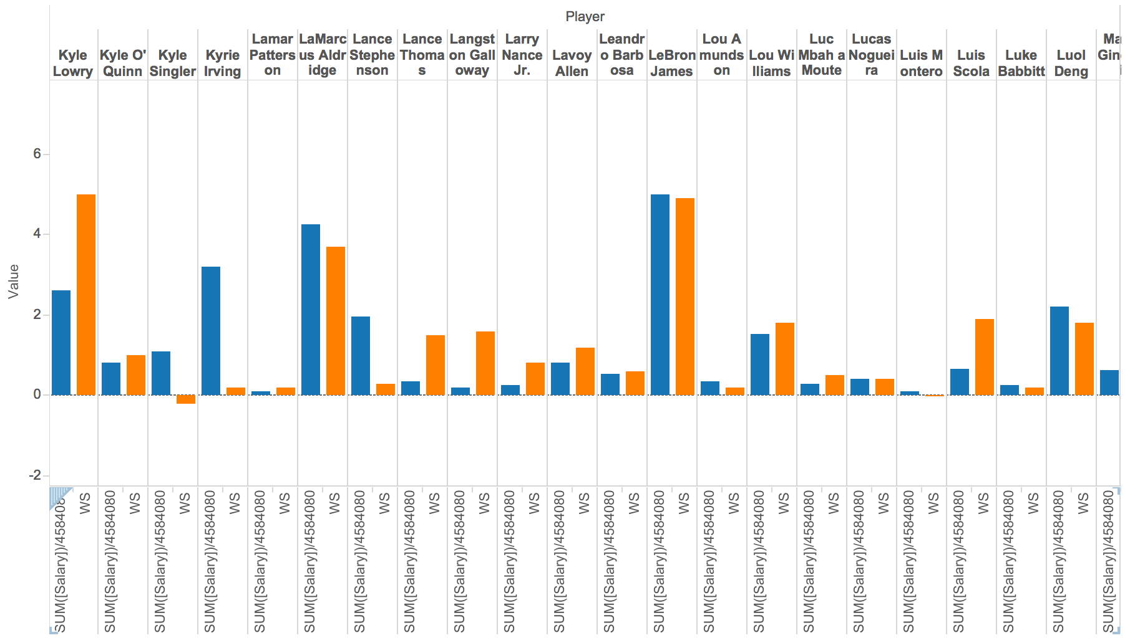
VISUALIZATION

Slide 11
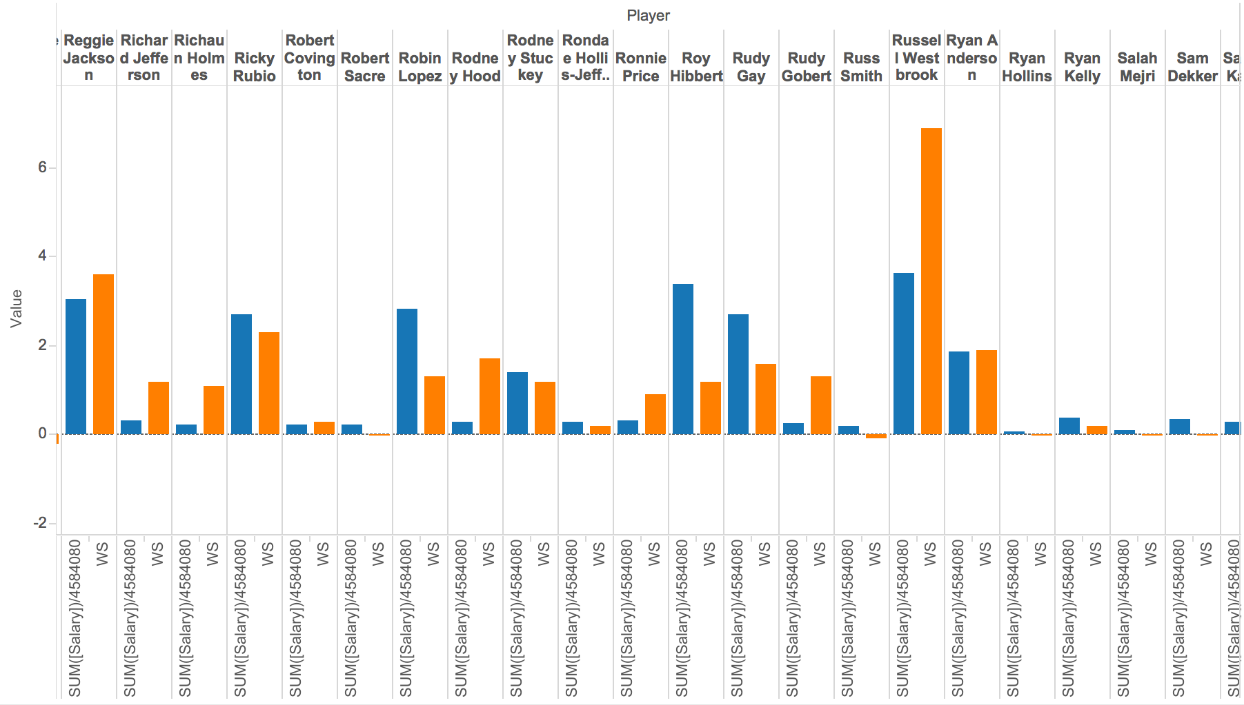
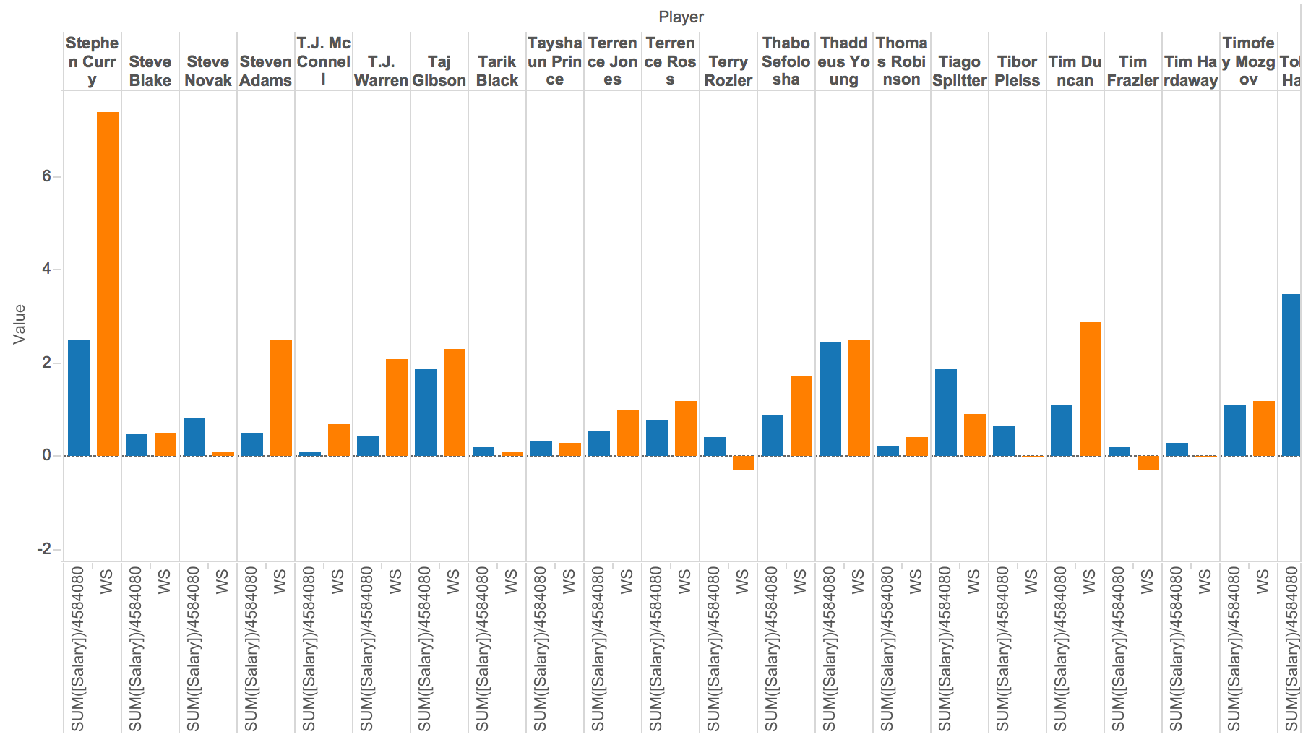
VISUALIZATION

Slide 12
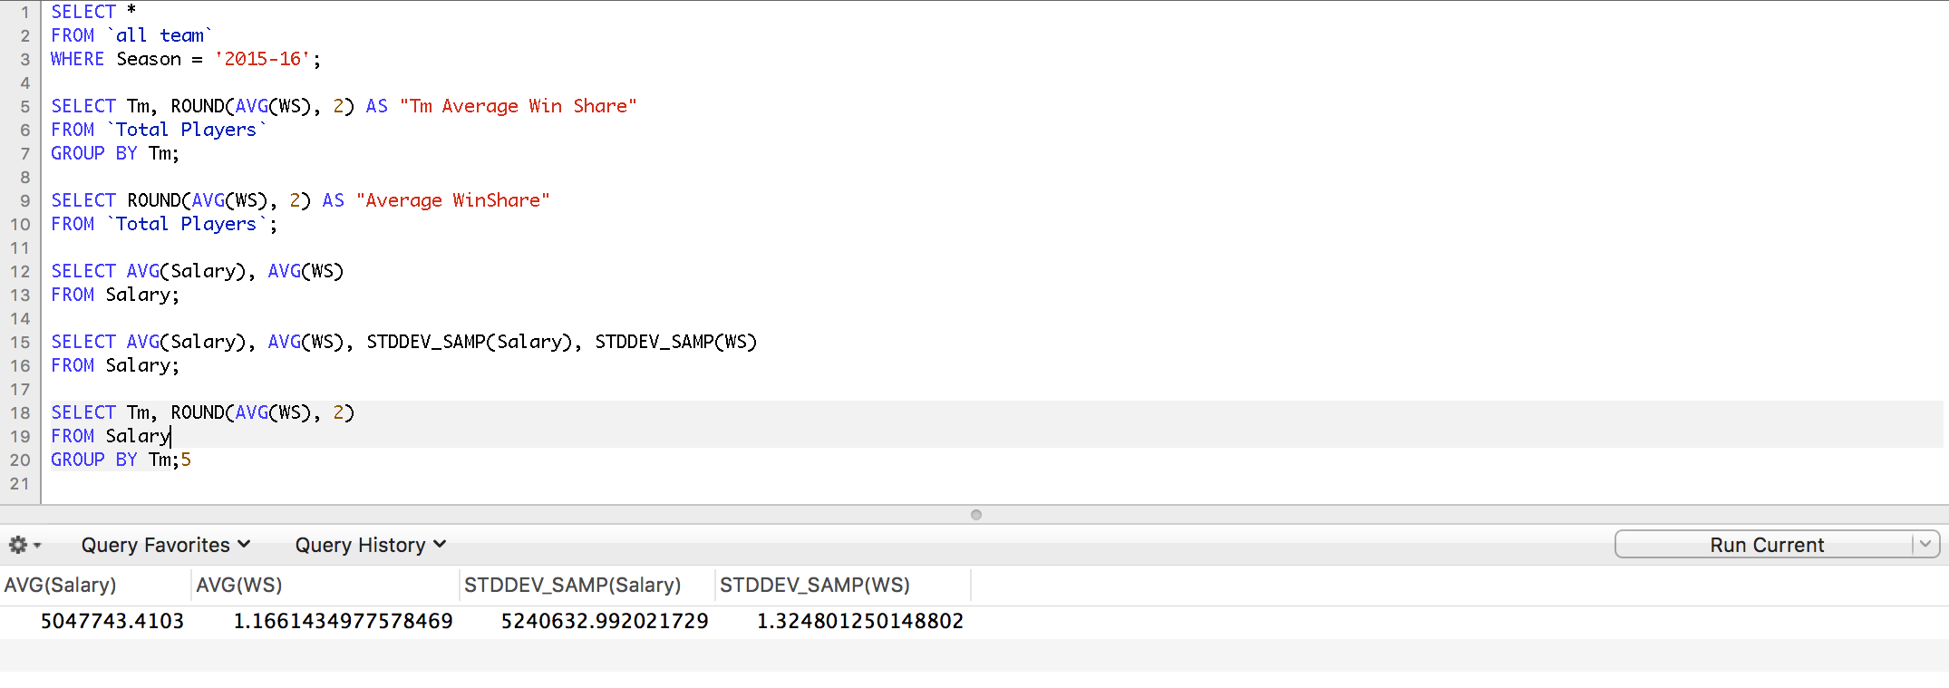
Which team makes
the greatest deal ?
Data Source
Season Stats, Player Stats
How to calculate?
Normalize the WS (Win Share) and Salary

Slide 13
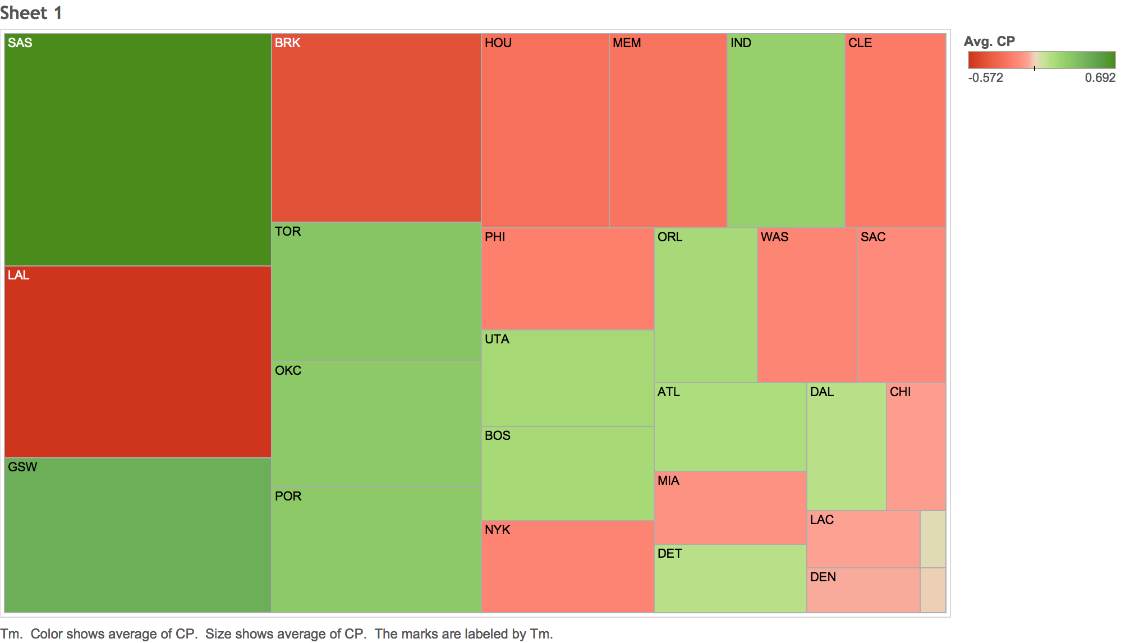
VISUALIZATION

Slide 14
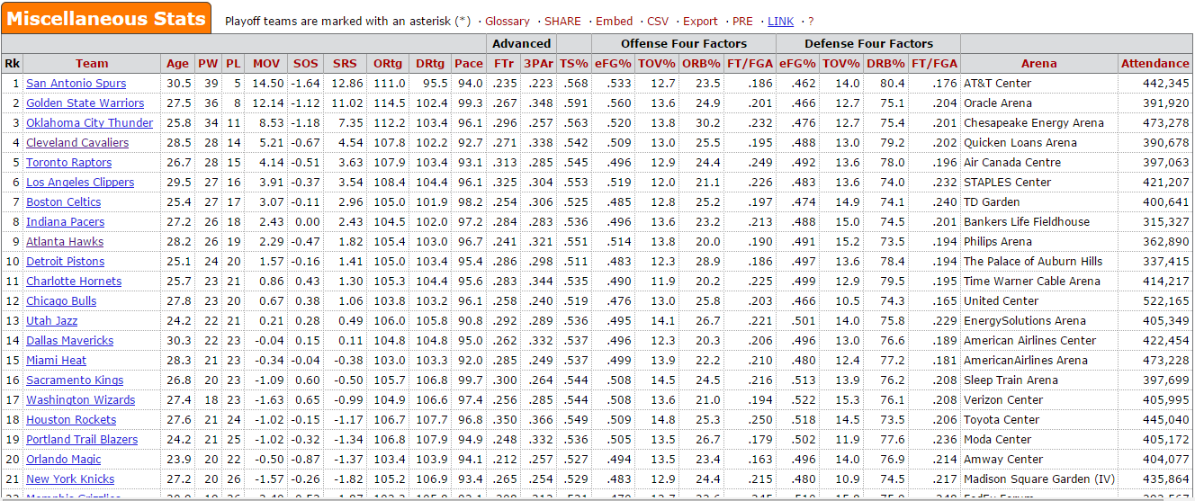
W%/Pace vs. Attendance
Data Source
Miscellaneous Stats from 2005 to 2015

Slide 15
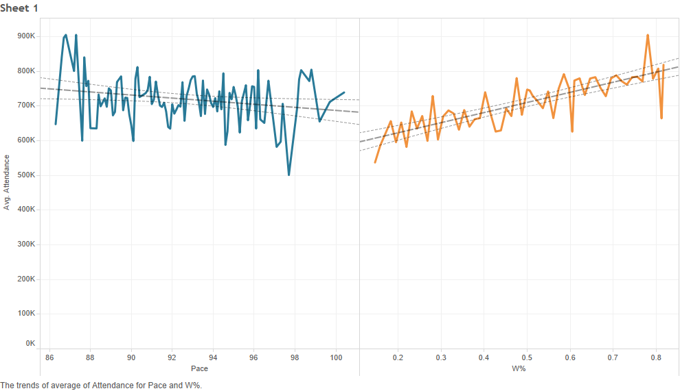
Visualization

Slide 16
Is Western Conference better than Eastern Conference?
Season | East Win | West Win
2015 | 577 | 653
2014 | 556 | 674
2013 | 577 | 653
2011 | 579 | 651

Slide 17
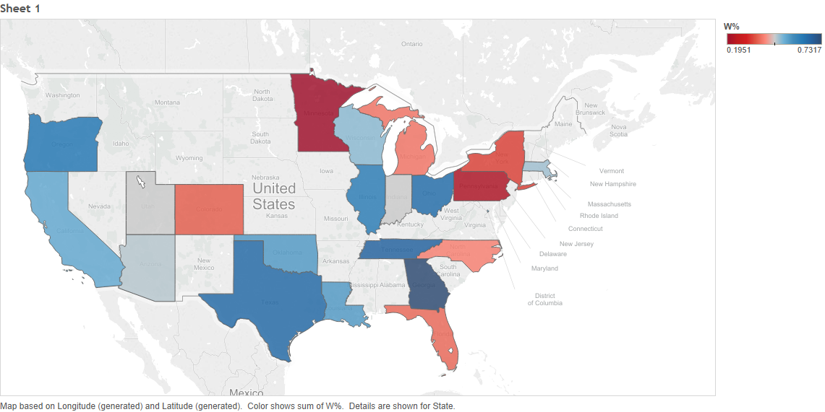
Visualization
2014-15

Slide 18
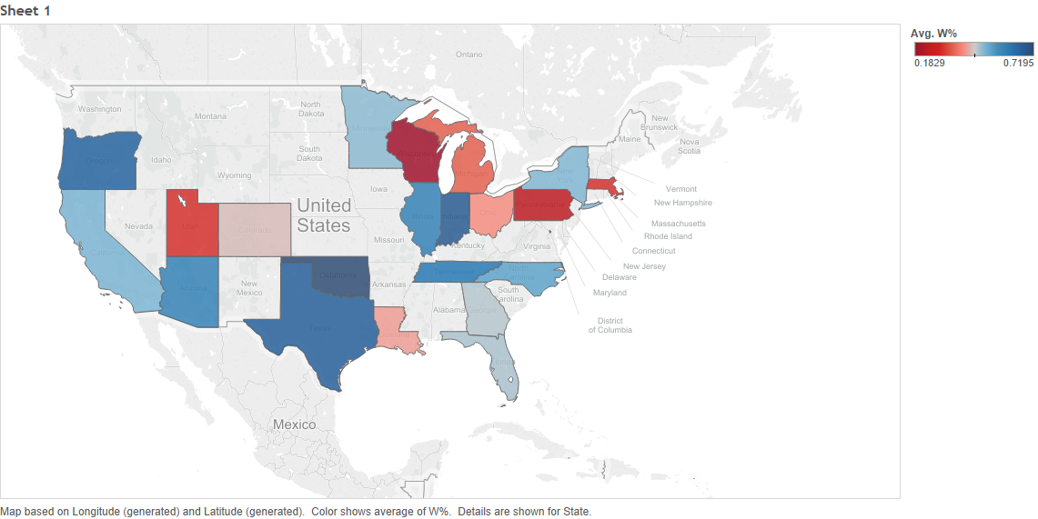
Visualization
2013-14

Slide 19
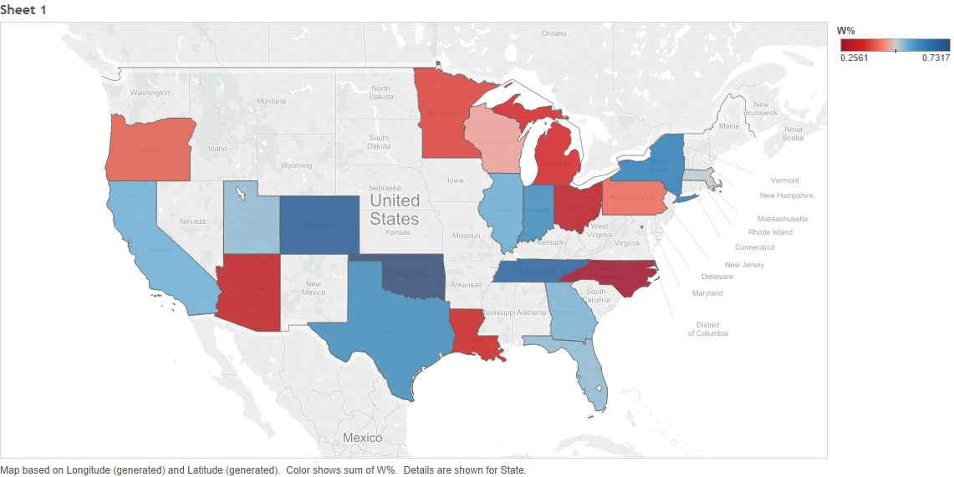
Visualization
2012-13

Slide 20
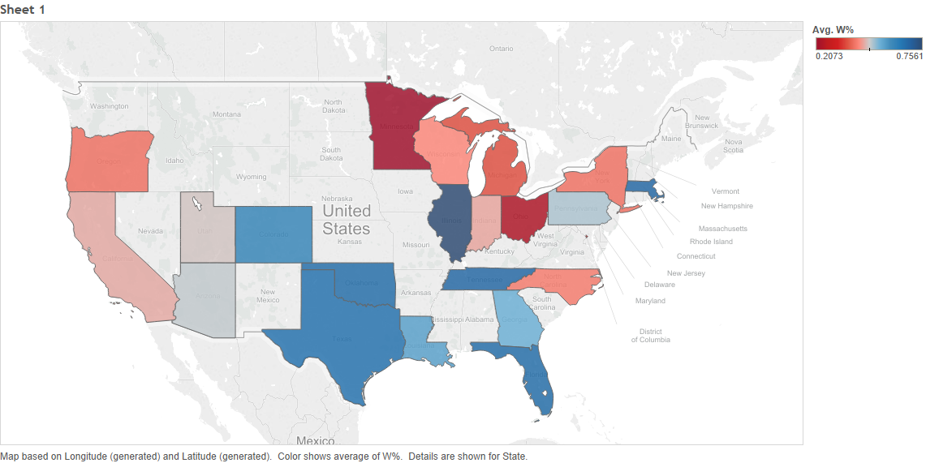
VIsualization
2010-11

Slide 21
Change of Styles
Change of the number of three pointers
Season | 2PA | 3PA
1980-81 | 85449 | 1981
1981-82 | 85911 | 2218
1982-83 | 87133 | 2242
1983-84 | 86043 | 2502
1984-85 | 84646 | 3185
1985-86 | 84374 | 3234
1986-87 | 84001 | 4847
1987-88 | 83248 | 5127
1988-89 | 82167 | 6807
1989-90 | 85586 | 7032
1990-91 | 85817 | 8104
1991-92 | 85042 | 8002
1992-93 | 82447 | 9344
1993-94 | 80354 | 10241
1994-95 | 71352 | 16429
1995-96 | 74658 | 18331
1996-97 | 72234 | 18987
1997-98 | 76486 | 15262
1998-99 | 46435 | 9340
1999-00 | 78192 | 16722
2000-01 | 77225 | 15942
2001-02 | 77322 | 17052
2002-03 | 82377 | 17486
2003-04 | 80022 | 18810
2004-05 | 78383 | 20501
2005-06 | 77490 | 19731
2006-07 | 76820 | 21816
2007-08 | 78614 | 22590
2008-09 | 78003 | 21725
2009-10 | 79714 | 21856
2010-11 | 78113 | 22816
2011-12 | 62640 | 18603
2012-13 | 76393 | 24747
2013-14 | 75900 | 27031
2014-15 | 75628 | 27932

Slide 22
VISualization

Slide 23
VISUALIZation

Slide 24
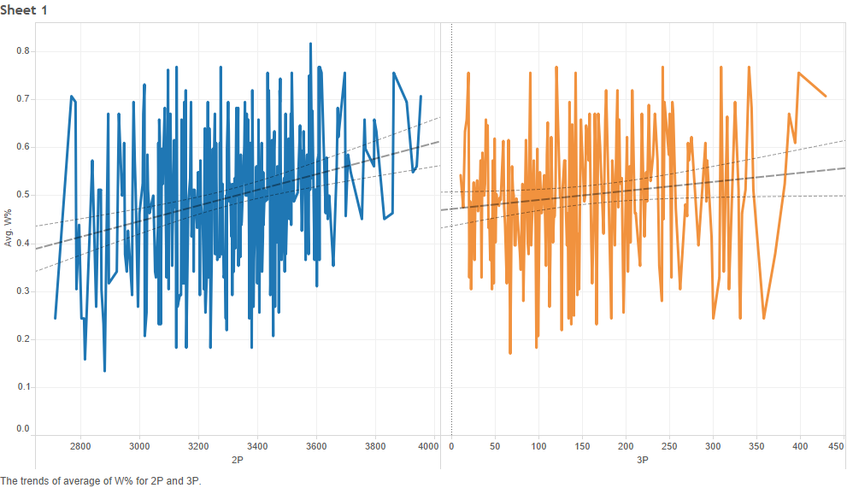
Change of styles
W% vs. 2p/3P(Before 1994-95)

Slide 25
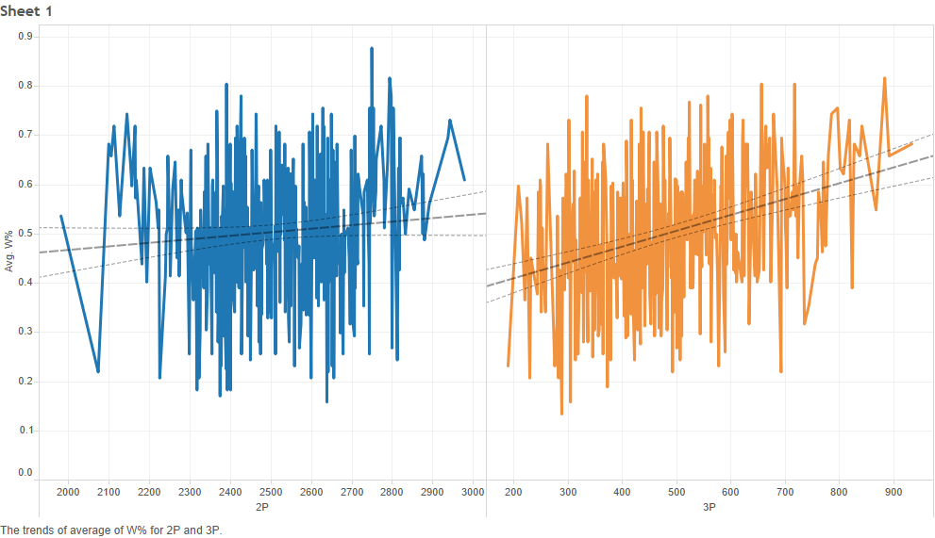
Change of styles
W% vs. 2p/3P(after 1994-95)

Slide 26
Extension
Find 2P/FG, 3P/FG, 2P%, 3P% for different period
of time to maximize W%
Identify players who are suitable for the current style
of NBA

Slide 27
Extension: Fail
Reason:
1. Only find the trend, not the relation
2. Winning percentage is too complicated, which is
not only related to 3P/FG, 3P%...
-> need some machine learning skill

Slide 28
Challenges we faced
1. Many data, but don’t know how to start
2. Exporting the data
3. Extra spaces, missing columns, redundant data…
4. Some problems when using the tools
5. Fail in analysis

Slide 29
Conclusion
What we’ve learned from the project
1. Choosing topics that are suitable for data analytics
2. Data cleaning and data integration
3. Tools for data analytics(Excel, MySQL, Tableau)
4. Some tips for data visualization
5. Hope to learn machine learning to do some more accurate analysis

Slide 30
Reference
Basketball Reference

Slide 31
Thanks for listening

